Slide 1


System Analysis And Design (SAD)
Smita Bisht
Assistant Professor
School of Polytechnic

Slide 2
About System Analysis And Design (SAD)
Systems Analysis and Design is an active field in which analysts repetitively learn new approaches and different techniques for building the system more effectively and efficiently.
The main objective of systems analysis and design is to improve organizational systems.

Slide 3
SYSTEM ANALYSTS:- A System Analyst is a person who uses analysis and design techniques to solve business problems using information technology.
Analysts study the environment and problems of an organization to determine whether a new information method can provide solution to the problem.

Slide 4

The main job of system analyst is to provide right type of information, in right quantity at the right time in post effective manner to the management or the end user.

Slide 5
System Analysis And Design
System Analysis Design

Slide 6
ANALYSIS:-means detailed examination of the elements or structure of something to understand its nature(basic meaning)
similarly
System Analysis is conducted for the purpose of studying a system or its parts in order to identify its objectives.
Analysis specifies What the system should do.

Slide 7
SYSTEM DESIGN:- Planning a new business system or replacing an existing one.
Before planning,
To understand the old system thoroughly and
Determine how computers can best be used in order to operate efficiently.
System Design focuses on how to accomplish the objective of the system.

Slide 8
SYSTEM:- Group of inter-related components that work together to achieve a common goal.
Systems are created to solve problems.
For e.g.:- University.
Traffic management system.
Automatic library system. etc.

Slide 9
What is a System??
The word System is derived from Greek word “Systema”.
A System is an orderly grouping of interdependent components, linked together according to a plan to achieve a specific objective/goal.

Slide 10
THREE BASIC IMPLICATIONS:
Structure and behavior.
Interconnectivity and interdependence
Higher priority to the objective of organization.

Slide 11
Elements of a System
Whenever we are going to reconstruct a system or going to represent any system, these six elements must be considered.
Output & Inputs.
Processor.
Control.
Feedback.
Environment.
Boundaries & Interface.

Slide 12
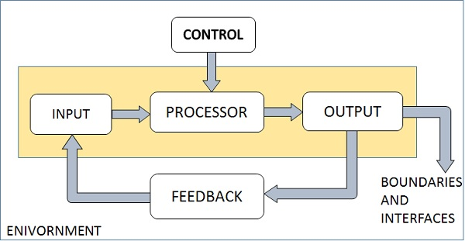
Elements of a System

Slide 13
Outputs and Inputs
What goes out from the system after being processed is known as Output.
Input is what data the system receives to produce a certain output.
Processor(s)
The processor is the element of a system that involves the actual transformation of input into output.

Slide 14
Control
The control element guides the system. It is the decision–making subsystem that controls the pattern of activities governing input, processing, and output.
Feedback.
It helps to achieve a much better control in the system. Feedback may be positive or negative, routine or informational.

Slide 15
Environment
The things outside the boundary of the system are known as environment. Change in the environment affects the working of the system.
Boundaries and Interface
A system should be defined by its boundaries.
Boundaries are the limits that identify its components, processes.
The interconnections and the interactions between the subsystem is known as Interface.

Slide 16


